Slide 1

Enterprise AI
TCS
INFRAMIND SEASON 4
Enhancing Customer Satisfaction : A research on how AI can help to improve customer satisfaction

Slide 2
About Me
Tirtharaj Ghosh
CT20203413680
Final year MCA student of Jadavpur University. (2018-2021)
Enthusiast in software development.

Slide 3

Enterprise AI
Overview
My project can collect feedbacks from any customer about any product. Using machine Learning algorithms, it can predict the sentiment score of the feedback. Thus generating Customer Satisfaction Index or CSAT index over time of the customers and as well as of the products also. It shows timeline graph of the satisfaction. It also calculates a customer’s priority on the business. And finally it is also able to determine customers’ sentiment of a product from social media posts.

Slide 4
Customer Sentiment
What is Customer Sentiment? And How to measure it?
Customer sentiment is the emotion customers feel overall toward your brand, product or service and can vary from positive to negative to neutral.
It is measured by Sentiment Score which is in between -1 and +1. The score indicates how negative or positive the overall text analyzed is. Anything below a score of -0.05 we tag as negative and anything above 0.05 we tag as positive. Anything in between inclusively, we tag as neutral.

Slide 5
Customer Satisfaction
What is Customer Satisfaction? And How to measure it?
Customer satisfaction is defined as a measurement that determines how happy customers are with a company's products, services, and capabilities. Customer satisfaction information, including surveys and ratings, can help a company determine how to best improve or changes its products and services.
It is measured by Customer Satisfaction Index or CSAT Index. It’s value lies in between 0 and 5 and is calculated by dividing all the positive responses by the total number of responses and multiplying by 5. This results in your CSAT index.

Slide 6
Enterprise AI
Structure of the project
Frontend
Backend
React JS
Bootstrap
Python Flask
Machine Learning
MySQL

Slide 7





Enterprise AI
MySQL Database
Frontend ( React )
Backend Server
( Python Flask )
Machine Learning

Slide 8
Code Base
TCS
INFRAMIND SEASON 4

Slide 9
Code Base
TCS
INFRAMIND SEASON 4

Slide 10
Web Application
TCS
INFRAMIND SEASON 4

Slide 11
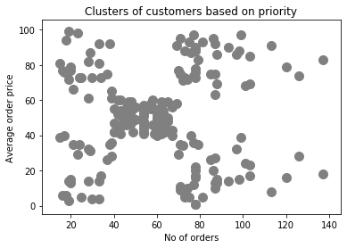
Customer Priority
Explaining Customer Priority
Plot an average order price vs. no of orders graph of all the customers.
Run through K-Means cluster algorithm of machine learning.

Slide 12
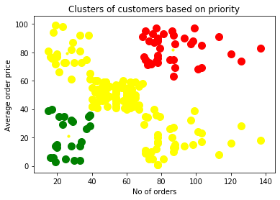
Customer Priority
Explaining Customer Priority
GREEN : Low Priority.
YELLOW: Normal Priority.
RED : High Priority. 70% of the total revenue comes from these customers.

Slide 13
Web Application
TCS
INFRAMIND SEASON 4

Slide 14
Enterprise AI
Bibliography
Stack Overflow
Geeks For Geeks
Medium

Slide 15
Thank You.
TCS
Tirtharaj Ghosh
INFRAMIND SEASON 4
+91 9564641639
tirtharajghosh.official@gmail.com
tirtharajghosh.github.io

